Slide 1

The C’s of Leadership
Knowledge is Power

Slide 2


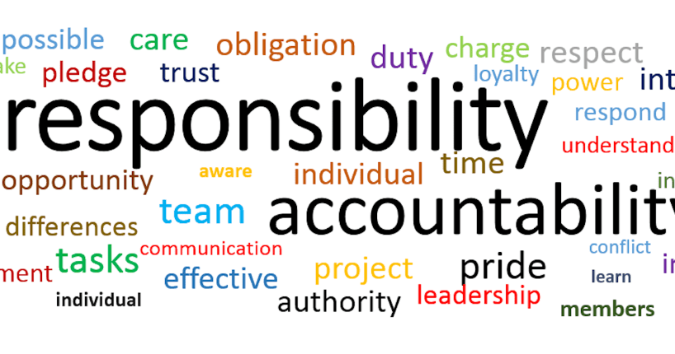

Confidence.
Individuals need to be a voice.
Tell each other we can do it.
Take responsibility.
Help others feel confident.
Believing in yourself.
This Photo by Unknown Author is licensed under CC BY-SA
Notes:
This Photo by Unknown Author is licensed under CC BY-ND

Slide 3
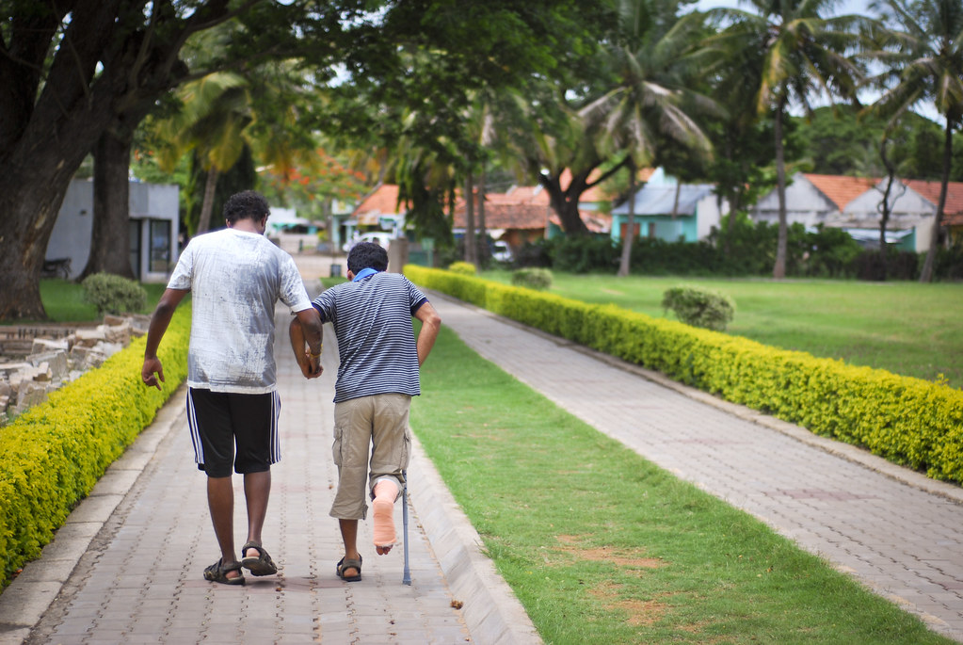






Character
Empathy and compassion
Kindness
Passion and vision
Patience
Self-awareness
Gratitude
Accountability
Notes:
This Photo by Unknown Author is licensed under CC BY-SA
This Photo by Unknown Author is licensed under CC BY-SA-NC
This Photo by Unknown Author is licensed under CC BY
Leadership HD Images - Search Images (bing.com)
his Photo by Unknown Author is licensed under CC BY-NC-ND

Slide 4







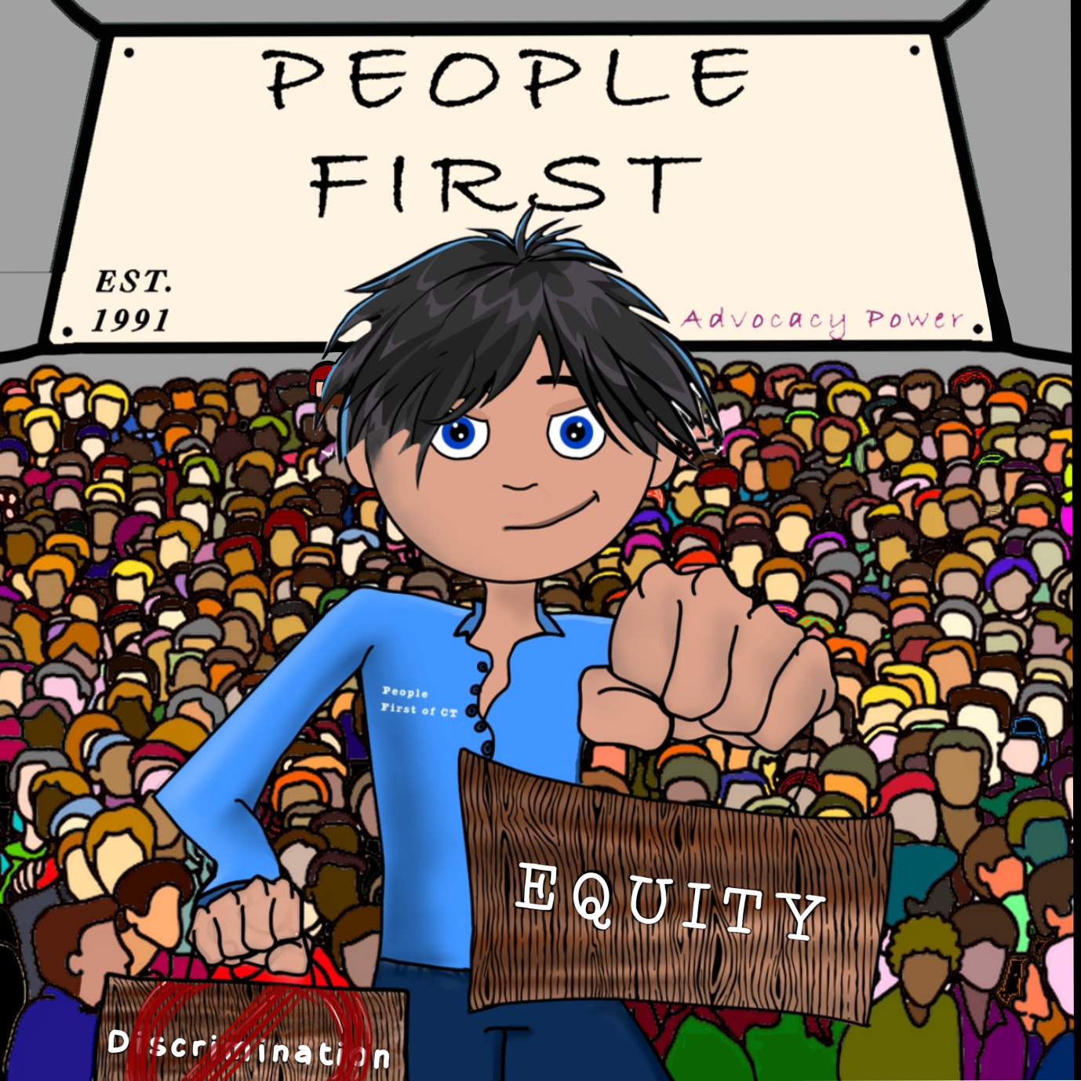
Character, cont.
Open-minded
Sincerity
Empowerment
Sense of Humor
Problem-solving
Loyalty
Integrity or honesty
And so so much more!!!
Notes:
This Photo by Unknown Author is licensed under CC BY-NC-ND
This Photo by Unknown Author is licensed under CC BY-NC-ND

Slide 5

Competence
Dignity of Risk while learning from mistakes.
Know what you’re talking about.
Lead from the head and the heart.
Find a mentor.
Professional attitude.
Empower people with the right know-how.

Slide 6

Collaboration
For example, with Housing corporations, individual landlords, job agencies.
Inviting people with expertise instead of doing what you’ve always done.
Give and take.
Be willing to compromise.
Develop positive relationships – before you need something.

Slide 7







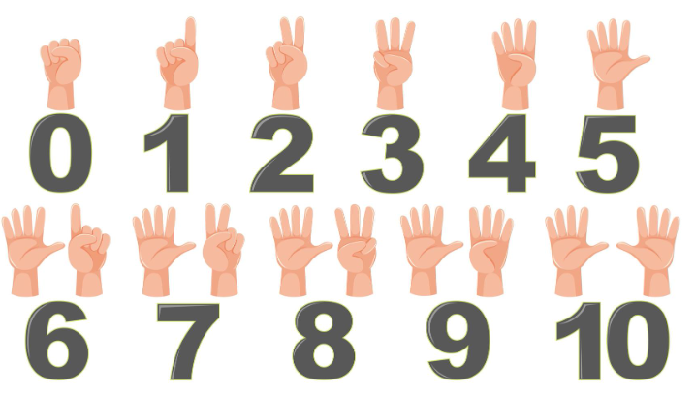




Coping skills
Smell the flowers blow out the candles
Stop, look around, and find things that are red or another color.
Use your stress ball. Count to 10.
Take a stretch break. Drink some water.
What else can you think of?

Slide 8
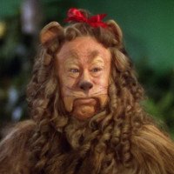
Courage
People need to try things and be strong.
Help people succeed in setting goals or what they want to do.
Remind self-advocates that they are just talking to other people in what is just a building.
Inspire others to accept changes.
Notes:
This Photo by Unknown Author is licensed under CC BY-SA-NC

Slide 9

Commitment
Know what you can do and keep helping them out.
Think about what you can do.
Be careful not to overcommit because once you do commit you can’t back out. You’ve got to stick with it.
Show you care about People First and show up!
Find the best in others – everyone has something to offer.
Notes:
This Photo by Unknown Author is licensed under CC BY-NC-ND

Slide 10

Creativity
Creative ideas and using your imagination in an appropriate way.
Try new ways and if it doesn’t work in a little while, come up with new ideas.
If we keep doing what we’ve been doing, people won’t get the services they need.

Slide 11

Communication
Help people with pictures, get an interpreter.
Use plain language.
Be “transparent” – explain why things are being done.
Encourage input.
Address concerns others have.
Notes:
This Photo by Unknown Author is licensed under CC BY

Slide 12

Communication, cont.
Make people feel valued.
Purpose is to connect and influence change.
Don’t let rumors develop.
Have a strategy to communicate.
Don’t be silent.
Notes:
This Photo by Unknown Author is licensed under CC BY-NC

Slide 13



Other things we learned
People have a hard time getting jobs bc of lack of transportation. There is too little funding in the budgets. Organizations are changing so people can get transportation like Uber and Lynx. There is a new service. Working on a reduced rate for people with disabilities (meaning they would pay less).
Housing is hard to get. People can’t afford to pay their bills. There is some way to help them. An example is free heating oil using fuel banks. Arcs are building affordable housing. They will be integrated with people w/out disabilities. People pool their money to pay for their utilities.
COLAs are not big enough to pay for rising costs.
This Photo by Unknown Author is licensed under CC BY
Notes:
This Photo by Unknown Author is licensed under CC BY
This Photo by Unknown Author is licensed under CC BY-NC-ND

Slide 14
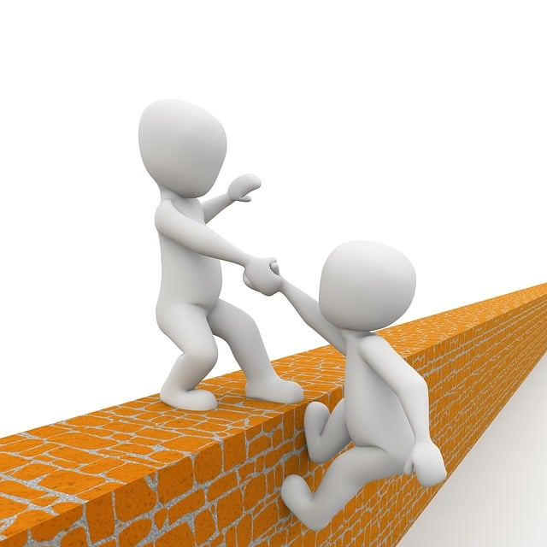
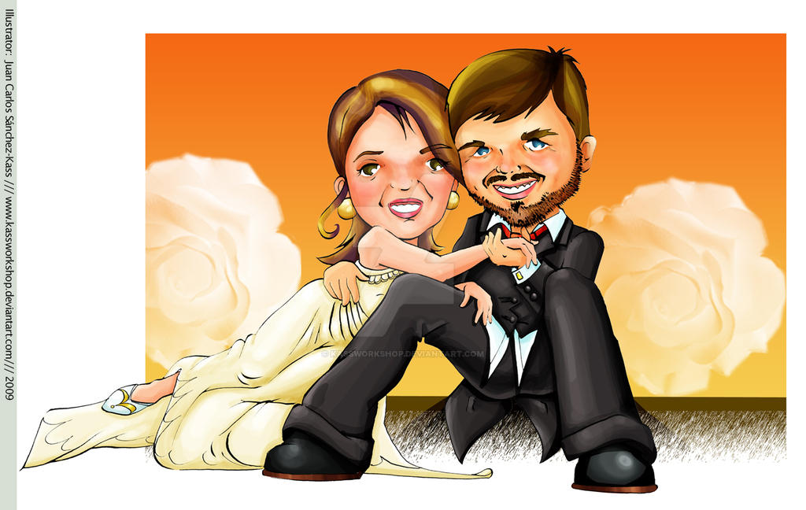

Other things we learned, cont.
Agencies need to provide more leadership to DSPs.
People who want to get married are given a hard time. Marriage penalties must end. They made arrangements for couples who were married.
Assistive technology helps people be more independent. They program the AT to meet individual needs.
This Photo by Unknown Author is licensed under CC BY-NC-ND
Notes:
This Photo by Unknown Author is licensed under CC BY-NC-ND

Slide 15


