Slide 1
What We Learned at TASH in New Orleans
By Josh Mears, Melissa Taylor, and Linda Rammler

Slide 2
About Advocacy
1. Your story matters and only you can tell it.
2. To be involved with advocacy, you have a right to ask for accessible materials to be involved with advocacy efforts

Slide 3
About Advocacy, cont.
A lot of us have the same questions:
Support is important, but how do we find “good” support so that we can reach our goals?
Community is important, but how do we build it if it doesn’t already exist?

Slide 4
Assistive Technology in Employment
Artificial Intelligence (AI) has a role
AI can help break down tasks into parts.
AI can provide reminders to employees.
AI can help build resumes, write cover letters, and so on.

Slide 5
Assistive Technology in Communication
– Everyone’s right
Making Low-Teach Assistive Technology in Minutes
Phone and tablet stands
Work area dividers

Slide 6
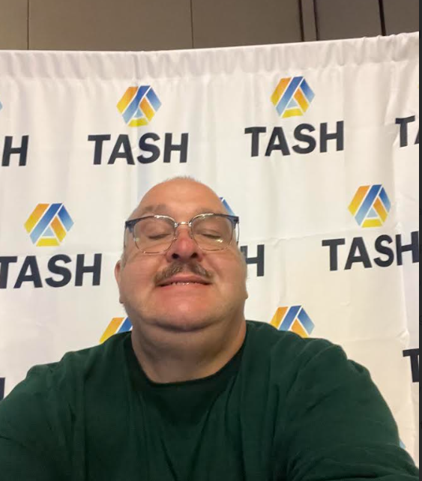
Networking is Important
Contacts with advocates from:
All over the US from Maine to California
Our friend, Mike, from New Orleans
Ireland!

Slide 7
TASH New England Get-together
There are 6 New England states
Rhode Island was not represented
ALL 5 have problems with Vocational Rehabilitation
ALL 5 agree the biggest problem is with the federal Rehabilitation Services Administration
We need to do something about this!

Slide 8
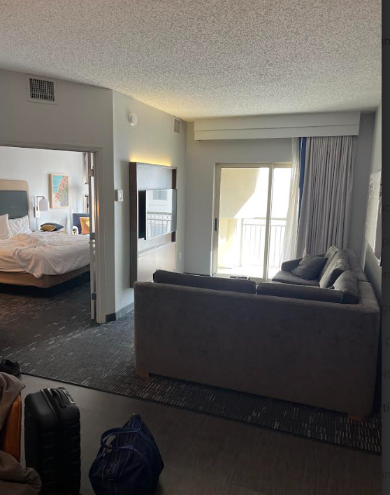
Sometimes being at a different hotel is a good thing
And sometimes it’s not…

Slide 9
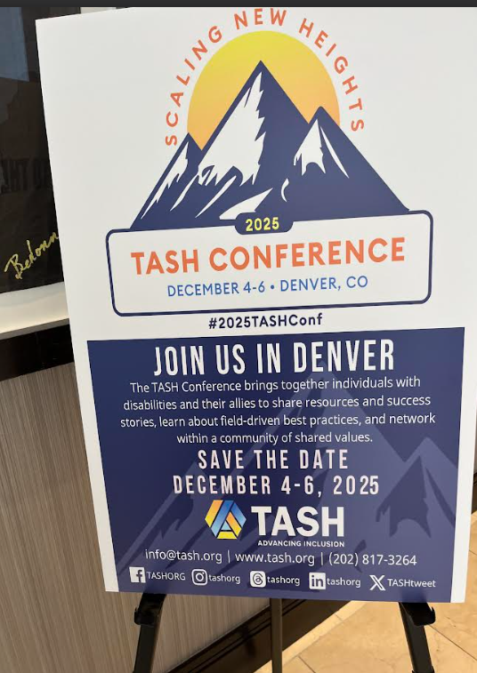
TASH 2025

Slide 10
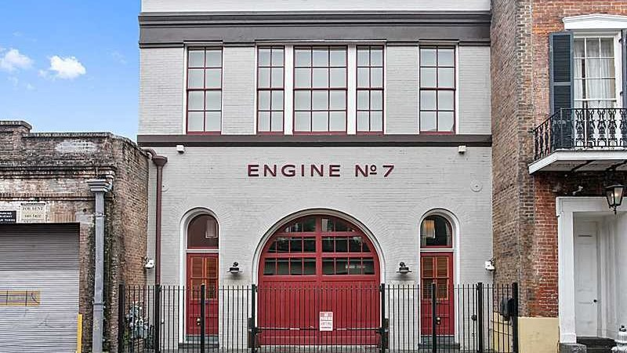
We Can Dream! (only $4.8M)

